Slide 1

Introduction to Probability and Statistics
Twelfth Edition
Robert J. Beaver • Barbara M. Beaver • William Mendenhall
Presentation designed and written by:
Barbara M. Beaver

Slide 2
Introduction to Probability and Statistics
Twelfth Edition
Chapter 11
The Analysis of Variance
Some graphic screen captures from Seeing Statistics ®
Some images © 2001-(current year) www.arttoday.com

Slide 3

Experimental Design
The sampling plan or experimental design determines the way that a sample is selected.
In an observational study, the experimenter observes data that already exist. The sampling plan is a plan for collecting this data.
In a designed experiment, the experimenter imposes one or more experimental conditions on the experimental units and records the response.

Slide 4
Definitions
An experimental unit is the object on which a measurement or measurements) is taken.
A factor is an independent variable whose values are controlled and varied by the experimenter.
A level is the intensity setting of a factor.
A treatment is a specific combination of factor levels.
The response is the variable being measured by the experimenter.

Slide 5
Example
A group of people is randomly divided into an experimental and a control group. The control group is given an aptitude test after having eaten a full breakfast. The experimental group is given the same test without having eaten any breakfast.
Experimental unit = Factor =
Response = Levels =
Treatments:
person
meal
Breakfast or no breakfast
Score on test
Breakfast or no breakfast

Slide 6
Example
The experimenter in the previous example also records the person’s gender. Describe the factors, levels and treatments.
Experimental unit = Response =
Factor #1 = Factor #2 =
Levels = Levels =
Treatments:
person
score
meal
gender
breakfast or no breakfast
male or female
male and breakfast, female and breakfast, male and no breakfast, female and no breakfast

Slide 7
The Analysis of Variance (ANOVA)
All measurements exhibit variability.
The total variation in the response measurements is broken into portions that can be attributed to various factors.
These portions are used to judge the effect of the various factors on the experimental response.

Slide 8
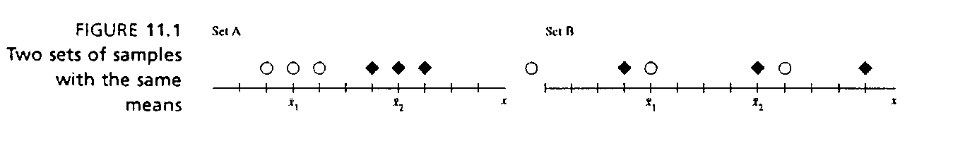
The Analysis of Variance
If an experiment has been properly designed,
Factor 1
Total variation
Factor 2
Random variation
We compare the variation due to any one factor to the typical random variation in the experiment.
The variation between the sample means is larger than the typical variation within the samples.
The variation between the sample means is about the same as the typical variation within the samples.

Slide 9
Assumptions
Similar to the assumptions required in Chapter 10.
The observations within each population are normally distributed with a common variance
σ ².
2. Assumptions regarding the sampling procedures are specified for each design.
Analysis of variance procedures are fairly robust when sample sizes are equal and when the data are fairly mound-shaped.

Slide 10
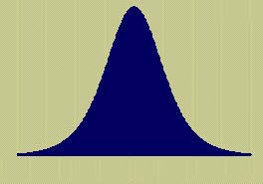
Three Designs
Completely randomized design: an extension of the two independent sample t-test.
Randomized block design: an extension of the paired difference test.
a × b Factorial experiment: we study two experimental factors and their effect on the response.

Slide 11
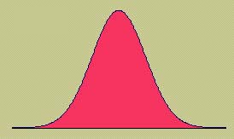
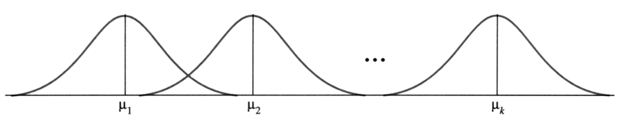
The Completely Randomized Design
A one-way classification in which one factor is set at k different levels.
The k levels correspond to k different normal populations, which are the treatments.
Are the k population means the same, or is at least one mean different from the others?

Slide 12
Example
Is the attention span of children
affected by whether or not they had a good breakfast? Twelve children were randomly divided into three groups and assigned to a different meal plan. The response was attention span in minutes during the morning reading time.
No Breakfast | Light Breakfast | Full Breakfast
8 | 14 | 10
7 | 16 | 12
9 | 12 | 16
13 | 17 | 15
k = 3 treatments. Are the average attention spans different?

Slide 13
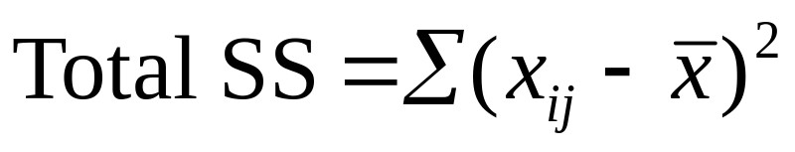
The Completely Randomized Design
Random samples of size n₁, n₂, …,n_{k} are drawn from k populations with means μ₁, μ₂,…, μ_{k} and with common variance σ².
Let x_{ij} be the j-th measurement in the i-th sample.
The total variation in the experiment is measured by the total sum of squares:

Slide 14

The Analysis of Variance
The Total SS is divided into two parts:
SST (sum of squares for treatments): measures the variation among the k sample means.
SSE (sum of squares for error): measures the variation within the k samples.
in such a way that:

Slide 15
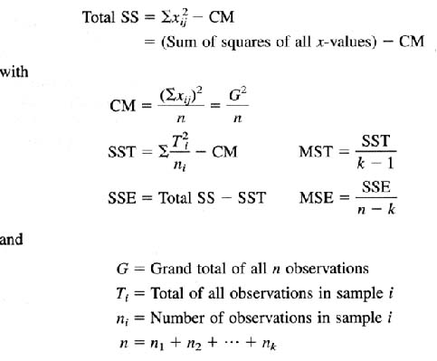
Computing Formulas

Slide 16
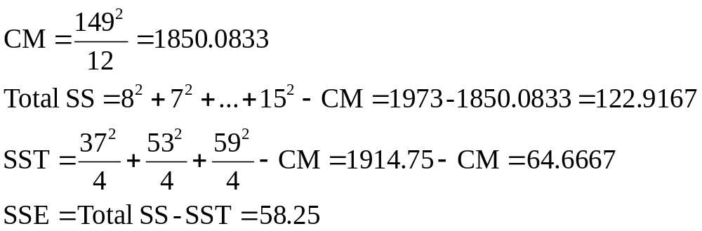
The Breakfast Problem
No Breakfast | Light Breakfast | Full Breakfast
8 | 14 | 10
7 | 16 | 12
9 | 12 | 16
13 | 17 | 15
T₁ = 37 | T₂ = 59 | T₃ = 53
G = 149

Slide 17
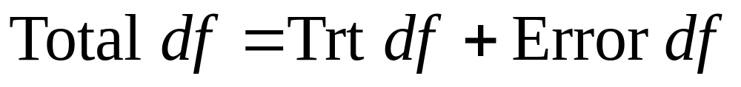
Degrees of Freedom and Mean Squares
These sums of squares behave like the numerator of a sample variance. When divided by the appropriate degrees of freedom, each provides a mean square, an estimate of variation in the experiment.
Degrees of freedom are additive, just like the sums of squares.

Slide 18
The ANOVA Table
Total df = Mean Squares
Treatment df =
Error df =
n₁+n₂+…+n_{k} –1 = n -1
k –1
MST = SST/(k-1)
n –1 – (k – 1) = n-k
MSE = SSE/(n-k)
Source | df | SS | MS | F
Treatments | k -1 | SST | SST/(k-1) | MST/MSE
Error | n - k | SSE | SSE/(n-k)
Total | n -1 | Total SS

Slide 19
The Breakfast Problem
Source | df | SS | MS | F
Treatments | 2 | 64.6667 | 32.3333 | 5.00
Error | 9 | 58.25 | 6.4722
Total | 11 | 122.9167

Slide 20
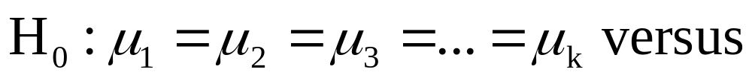
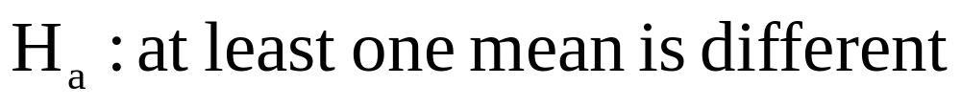
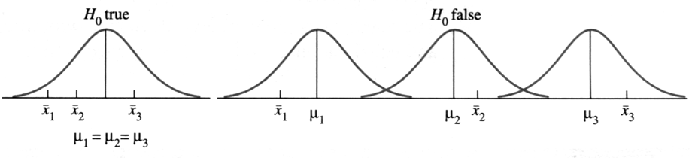
Testing the Treatment Means
Remember that σ ² is the common variance for all k populations. The quantity MSE = SSE/(n − k) is a pooled estimate of σ ², a weighted average of all k sample variances, whether or not H ₀ is true.

Slide 21
If H ₀ is true, then the variation in the sample means, measured by MST = [SST/ (k − 1)], also provides an unbiased estimate of σ ².
However, if H ₀ is false and the population means are different, then MST— which measures the variance in the sample means — is unusually large. The test statistic F = MST/ MSE tends to be larger that usual.

Slide 22
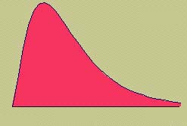
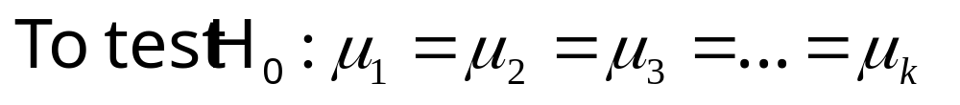
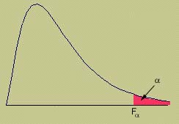
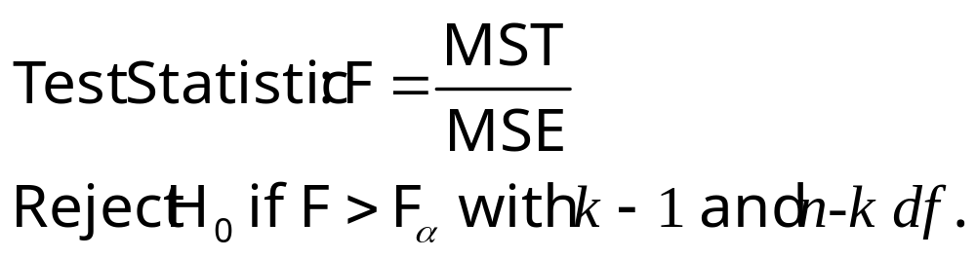
The F Test
MY
APPLET
  Hence, you can reject H ₀ for large values of F, using a right-tailed statistical test.
When H ₀ is true, this test statistic has an F distribution with d f ₁ = (k − 1) and d f ₂ = (n − k) degrees of freedom and right-tailed critical values of the F distribution can be used.

Slide 23
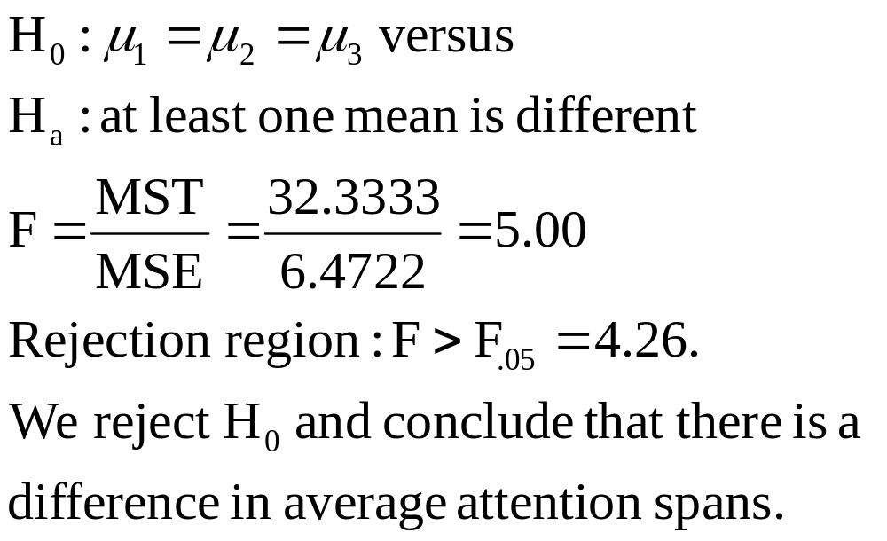
The Breakfast Problem
Source | df | SS | MS | F
Treatments | 2 | 64.6667 | 32.3333 | 5.00
Error | 9 | 58.25 | 6.4722
Total | 11 | 122.9167
MY
APPLET

Slide 24
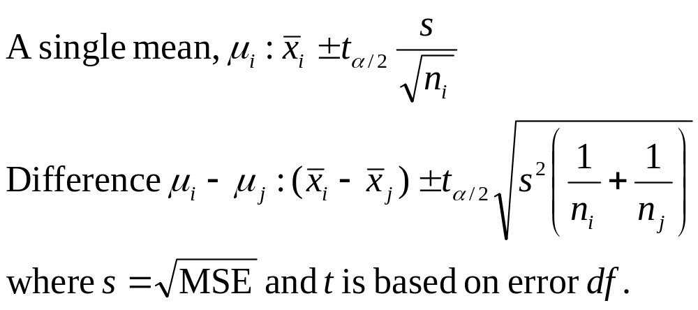
Confidence Intervals
  If a difference exists between the treatment means, we can explore it with confidence intervals.

Slide 25
Tukey’s Method for
Paired Comparisons
  Designed to test all pairs of population means simultaneously, with an overall error rate of α.
  Based on the studentized range, the difference between the largest and smallest of the k sample means.
  Assume that the sample sizes are equal and calculate a “ruler” that measures the distance required between any pair of means to declare a significant difference.

Slide 26
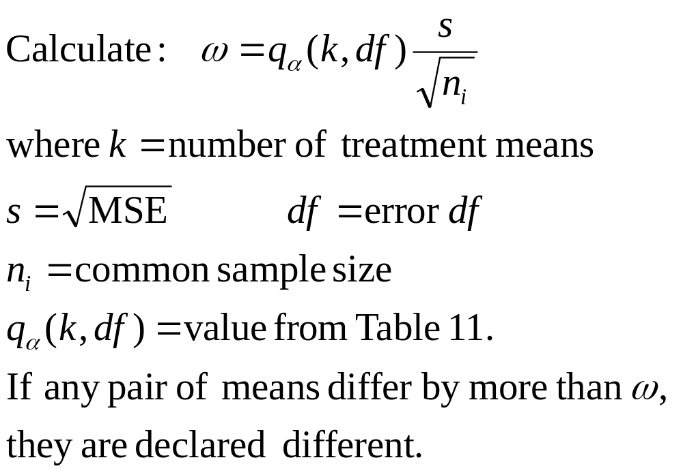
Tukey’s Method

Slide 27
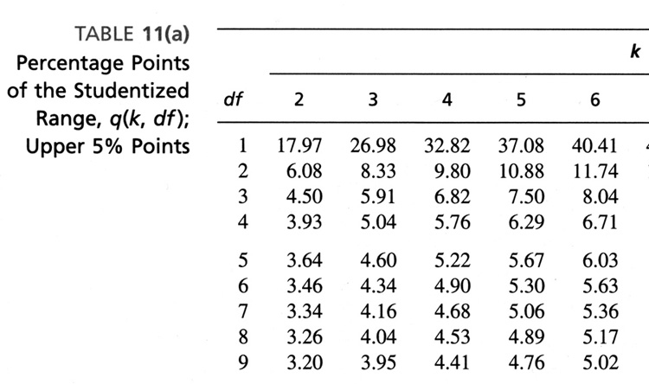
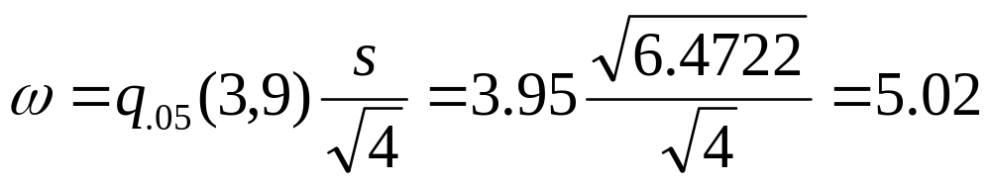
The Breakfast Problem
Use Tukey’s method to determine which of the three population means differ from the others.
 | No Breakfast | Light Breakfast | Full Breakfast
 | T₁ = 37 | T₂ = 59 | T₃ = 53
Means | 37/4 = 9.25 | 59/4 = 14.75 | 53/4 = 13.25

Slide 28
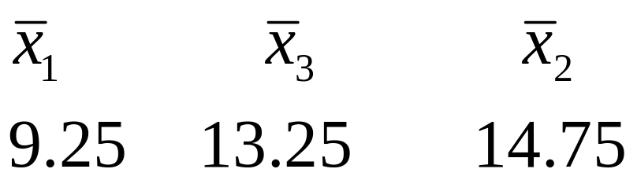
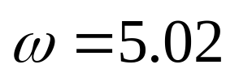
The Breakfast Problem
List the sample means from smallest to largest.
Since the difference between 9.25 and 13.25 is less than ω = 5.02, there is no significant difference. There is a difference between population means 1 and 2 however.
We can declare a significant difference in average attention spans between “no breakfast” and “light breakfast”, but not between the other pairs.
There is no difference between 13.25 and 14.75.

Slide 29
The Randomized
Block Design
A direct extension of the paired difference or matched pairs design.
A two-way classification in which k treatment means are compared.
The design uses blocks of k experimental units that are relatively similar or homogeneous, with one unit within each block randomly assigned to each treatment.

Slide 30
The Randomized
Block Design
If the design involves k treatments within each of b blocks, then the total number of observations is n = bk.
The purpose of blocking is to remove or isolate the block-to-block variability that might hide the effect of the treatments.
There are two factors—treatments and blocks, only one of which is of interest to the experimenter.

Slide 31

Example
We want to investigate the affect of
3 methods of soil preparation on the growth of seedlings. Each method is applied to seedlings growing at each of 4 locations and the average first year
growth is recorded.
 | Location
Soil Prep | 1 | 2 | 3 | 4
A | 11 | 13 | 16 | 10
B | 15 | 17 | 20 | 12
C | 10 | 15 | 13 | 10
Treatment = soil preparation (k = 3)
Block = location (b = 4)
Is the average growth different for the 3 soil preps?

Slide 32
The Randomized
Block Design
Let x_{ij} be the response for the i-th treatment applied to the j-th block.
  i = 1, 2, …k j = 1, 2, …, b
The total variation in the experiment is measured by the total sum of squares:

Slide 33
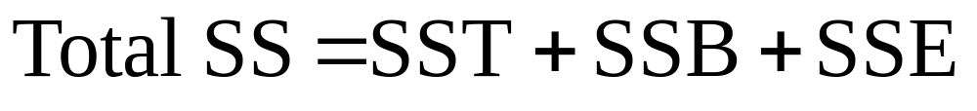
The Analysis of Variance
The Total SS is divided into 3 parts:
SST (sum of squares for treatments): measures the variation among the k treatment means
SSB (sum of squares for blocks): measures the variation among the b block means
SSE (sum of squares for error): measures the random variation or experimental error
in such a way that:

Slide 34
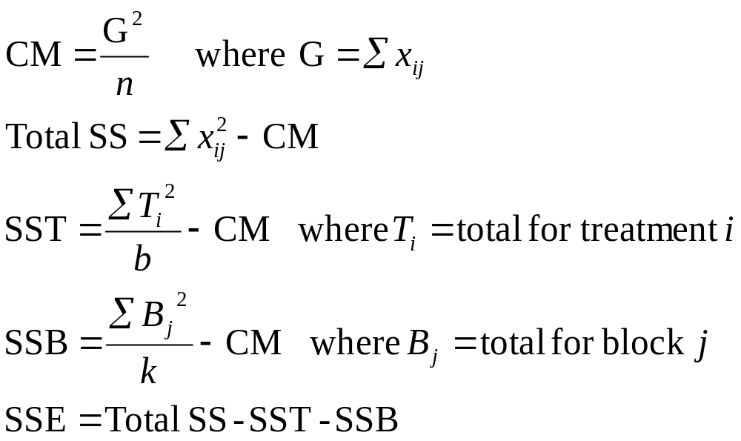
Computing Formulas

Slide 35
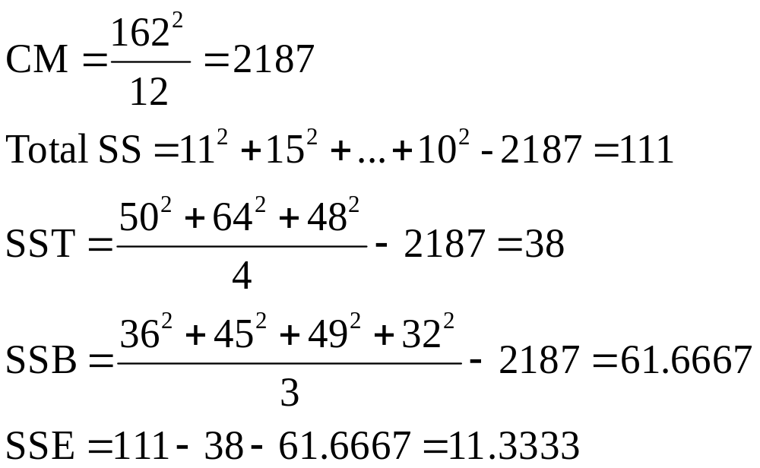
The Seedling Problem
 | Locations
Soil Prep | 1 | 2 | 3 | 4 | T_{i}
A | 11 | 13 | 16 | 10 | 50
B | 15 | 17 | 20 | 12 | 64
C | 10 | 15 | 13 | 10 | 48
B_{j} | 36 | 45 | 49 | 32 | 162

Slide 36
The ANOVA Table
Total df = Mean Squares
Treatment df =
Block df =
Error df =
bk –1 = n -1
k –1
MST = SST/(k-1)
b –1
MSB = SSB/(b-1)
bk– (k – 1) – (b-1) = (k-1)(b-1)
MSE = SSE/(k-1)(b-1)
Source | df | SS | MS | F
Treatments | k -1 | SST | SST/(k-1) | MST/MSE
Blocks | b -1 | SSB | SSB/(b-1) | MSB/MSE
Error | (b-1)(k-1) | SSE | SSE/(b-1)(k-1)
Total | n -1 | Total SS

Slide 37
The Seedling Problem
Source | df | SS | MS | F
Treatments | 2 | 38 | 19 | 10.06
Blocks | 3 | 61.6667 | 20.5556 | 10.88
Error | 6 | 11.3333 | 1.8889
Total | 11 | 122.9167

Slide 38
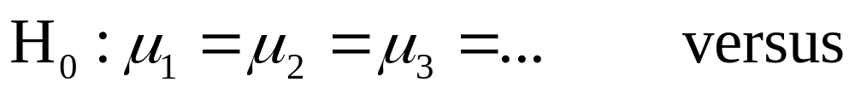
Testing the Treatment and Block Means
For either treatment or block means, we can test:
Remember that σ ² is the common variance for all bk treatment/block combinations. MSE is the best estimate of σ ², whether or not H ₀ is true.

Slide 39
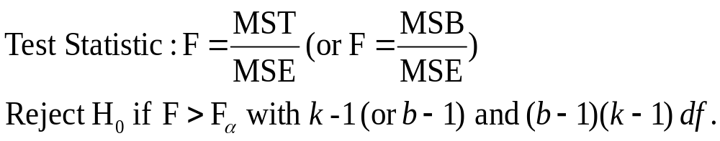
If H ₀ is false and the population means are different, then MST or MSB— whichever you are testing— will unusually large. The test statistic F = MST/ MSE (or F = MSB/ MSE) tends to be larger that usual.
We use a right-tailed F test with the appropriate degrees of freedom.

Slide 40
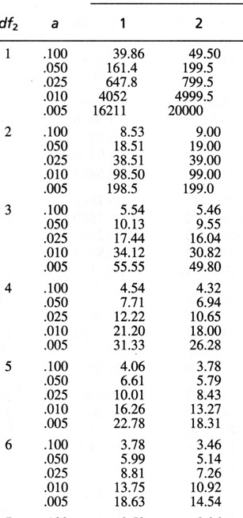
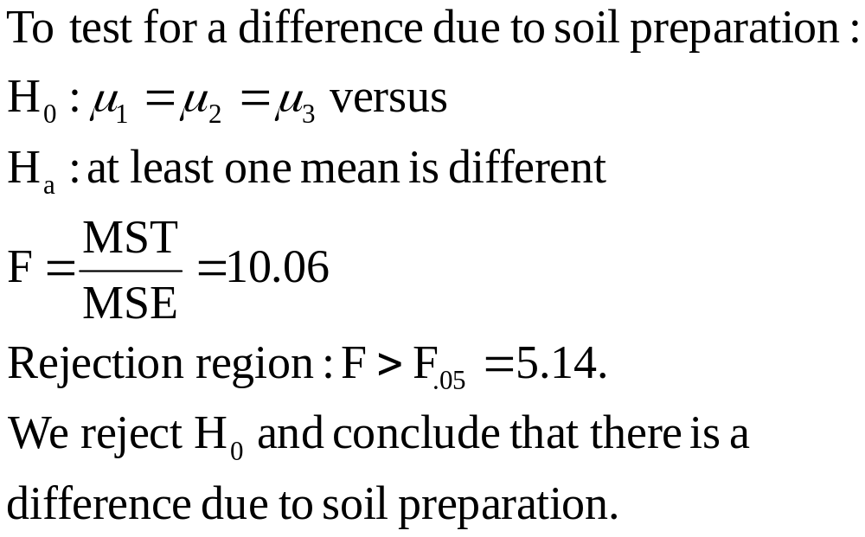
The Seedling Problem
Source | df | SS | MS | F
Soil Prep (Trts) | 2 | 38 | 19 | 10.06
Location (Blocks) | 3 | 61.6667 | 20.5556 | 10.88
Error | 6 | 11.3333 | 1.8889
Total | 11 | 122.9167
Although not of primary importance, notice that the blocks (locations) were also significantly different (F = 10.88)
MY
APPLET

Slide 41
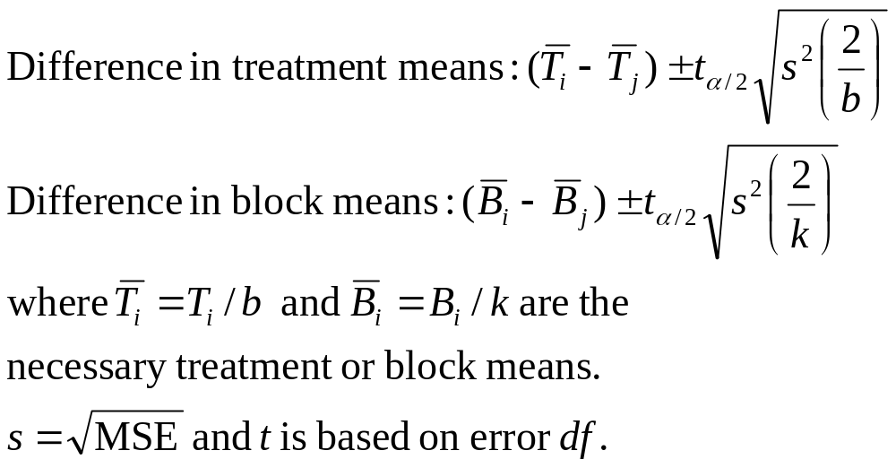
Confidence Intervals
  If a difference exists between the treatment means or block means, we can explore it with confidence intervals or using Tukey’s method.

Slide 42
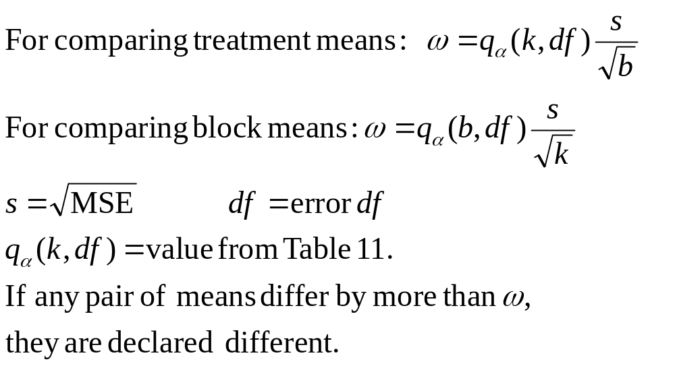
Tukey’s Method

Slide 43
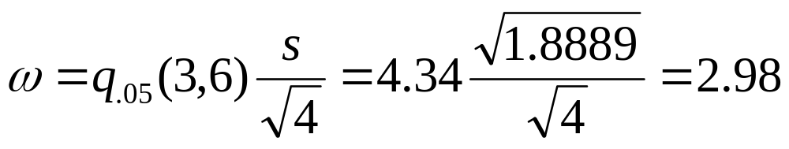
The Seedling Problem
Use Tukey’s method to determine which of the three soil preparations differ from the others.
 | A (no prep) | B (fertilization) | C (burning)
 | T₁ = 50 | T₂ = 64 | T₃ = 48
Means | 50/4 = 12.5 | 64/4 = 16 | 48/4 = 12

Slide 44
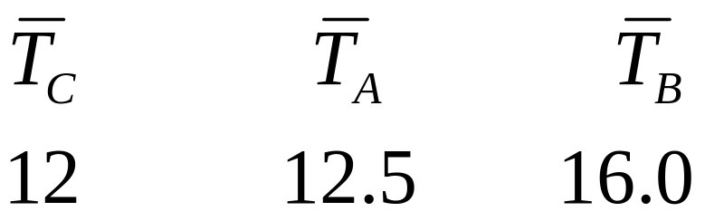
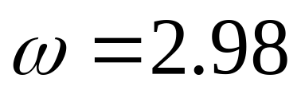
The Seedling Problem
List the sample means from smallest to largest.
Since the difference between 12 and 12.5 is less than ω = 2.98, there is no significant difference. There is a difference between population means C and B however.
A significant difference in average growth only occurs when the soil has been fertilized.
There is a significant difference between A and B.

Slide 45
Cautions about Blocking
A randomized block design should not be used when treatments and blocks both correspond to experimental factors of interest to the researcher
Remember that blocking may not always be beneficial.
Remember that you cannot construct confidence intervals for individual treatment means unless it is reasonable to assume that the b blocks have been randomly selected from a population of blocks.

Slide 46
An a x b Factorial
Experiment
A two-way classification in which involves two factors, both of which are of interest to the experimenter.
There are a levels of factor A and b levels of factor B—the experiment is replicated r times at each factor-level combination.
The replications allow the experimenter to investigate the interaction between factors A and B.

Slide 47
Interaction
The interaction between two factor A and B is the tendency for one factor to behave differently, depending on the particular level setting of the other variable.
Interaction describes the effect of one factor on the behavior of the other. If there is no interaction, the two factors behave independently.

Slide 48

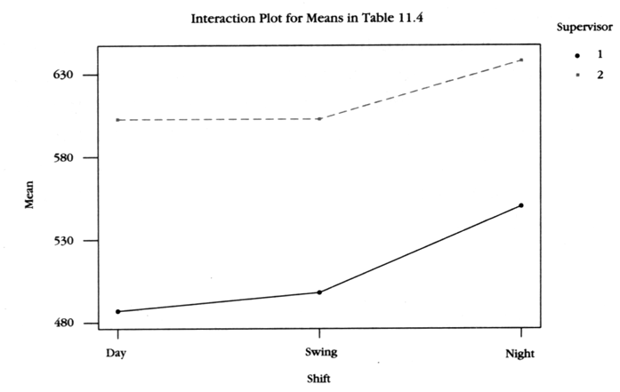
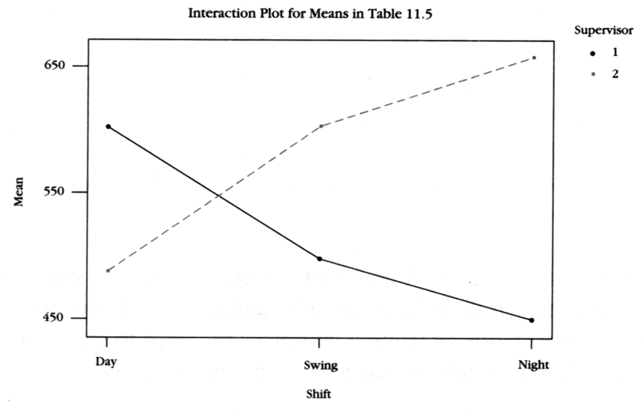
Example
A drug manufacturer has three
supervisors who work at each of three different shift times. Do outputs of the supervisors behave differently, depending on the particular shift they are working?
Supervisor 1 always does better than 2, regardless of the shift.
(No Interaction)
Supervisor 1 does better earlier in the day, while supervisor 2 does better at night.
(Interaction)

Slide 49
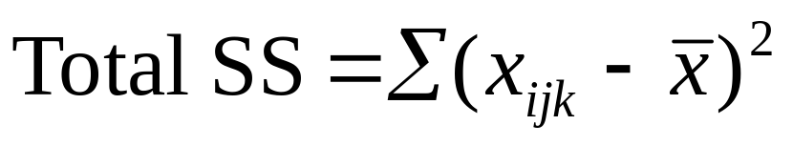
The a x b Factorial Experiment
Let x_{ijk} be the k-th replication at the i-th level of A and the j-th level of B.
  i = 1, 2, …,a j = 1, 2, …, b
  k = 1, 2, …,r
The total variation in the experiment is measured by the total sum of squares:

Slide 50
The Analysis of Variance
The Total SS is divided into 4 parts:
SSA (sum of squares for factor A): measures the variation among the means for factor A
SSB (sum of squares for factor B): measures the variation among the means for factor B
SS(AB) (sum of squares for interaction): measures the variation among the ab combinations of factor levels
SSE (sum of squares for error): measures experimental error in such a way that:

Slide 51
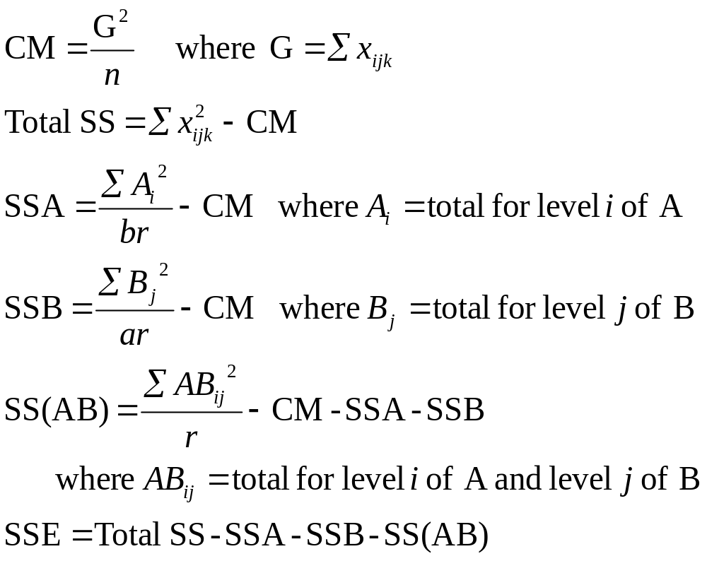
Computing Formulas

Slide 52
The Drug Manufacturer
Each supervisors works at each of
three different shift times and the shift’s output is measured on three randomly selected days.
Supervisor | Day | Swing | Night | A_{i}
1 | 571 610 625 | 480 474 540 | 470 430 450 | 4650
2 | 480 516 465 | 625 600 581 | 630 680 661 | 5238
B_{j} | 3267 | 3300 | 3321 | 9888

Slide 53
The ANOVA Table
Total df = Mean Squares
Factor A df =
Factor B df =
Interaction df =
Error df =
n –1 = abr - 1
a –1
MSA= SSA/(k-1)
b –1
MSB = SSB/(b-1)
(a-1)(b-1)
MS(AB) = SS(AB)/(a-1)(b-1)
by subtraction
MSE = SSE/ab(r-1)
Source | df | SS | MS | F
A | a -1 | SST | SST/(a-1) | MST/MSE
B | b -1 | SSB | SSB/(b-1) | MSB/MSE
Interaction | (a-1)(b-1) | SS(AB) | SS(AB)/(a-1)(b-1) | MS(AB)/MSE
Error | ab(r-1) | SSE | SSE/ab(r-1)
Total | abr -1 | Total SS

Slide 54
The Drug Manufacturer
We generate the ANOVA table using Minitab (Stat→ANOVA →Two way).
Two-way ANOVA: Output versus Supervisor, Shift
Source DF SS MS F P
Supervisor 1 19208 19208.0 26.68 0.000
Shift 2 247 123.5 0.17 0.844
Interaction 2 81127 40563.5 56.34 0.000
Error 12 8640 720.0
Total 17 109222

Slide 55
Tests for a Factorial Experiment
We can test for the significance of both factors and the interaction using F-tests from the ANOVA table.
Remember that σ ² is the common variance for all ab factor-level combinations. MSE is the best estimate of σ ², whether or not H ₀ is true.
Other factor means will be judged to be significantly different if their mean square is large in comparison to MSE.

Slide 56
Tests for a Factorial Experiment
The interaction is tested first using F = MS(AB)/MSE.
If the interaction is not significant, the main effects A and B can be individually tested using F = MSA/MSE and F = MSB/MSE, respectively.
If the interaction is significant, the main effects are NOT tested, and we focus on the differences in the ab factor-level means.

Slide 57
The Drug Manufacturer
Two-way ANOVA: Output versus Supervisor, Shift
Source DF SS MS F P
Supervisor 1 19208 19208.0 26.68 0.000
Shift 2 247 123.5 0.17 0.844
Interaction 2 81127 40563.5 56.34 0.000
Error 12 8640 720.0
Total 17 109222
The test statistic for the interaction is F = 56.34 with p-value = .000. The interaction is highly significant, and the main effects are not tested. We look at the interaction plot to see where the differences lie.

Slide 58
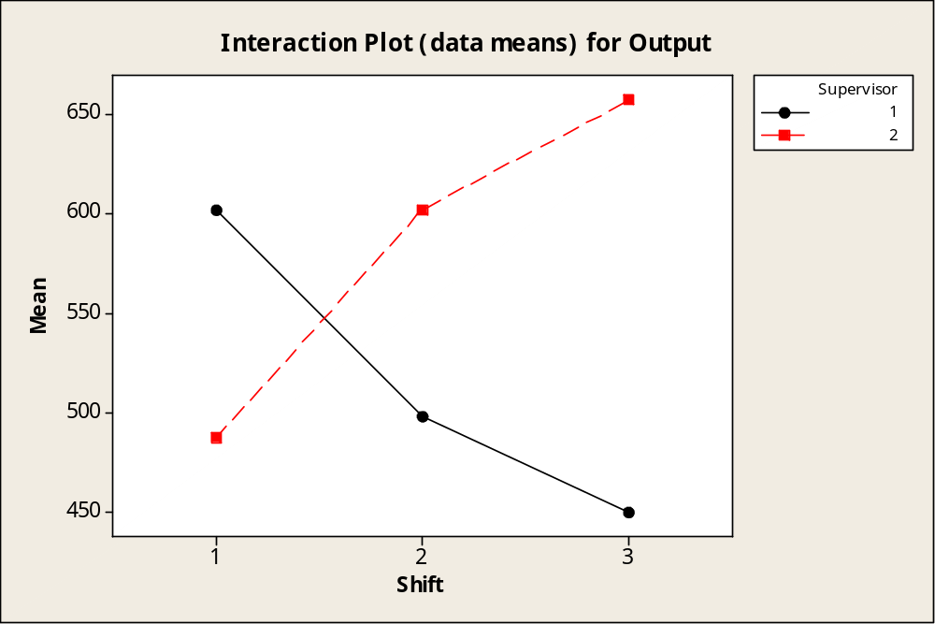
The Drug Manufacturer
Supervisor 1 does better earlier in the day, while supervisor 2 does better at night.

Slide 59
Revisiting the
ANOVA Assumptions
The observations within each population are normally distributed with a common variance
σ ².
2. Assumptions regarding the sampling procedures are specified for each design.
Remember that ANOVA procedures are fairly robust when sample sizes are equal and when the data are fairly mound-shaped.

Slide 60
Diagnostic Tools
Many computer programs have graphics options that allow you to check the normality assumption and the assumption of equal variances.
Normal probability plot of residuals
2. Plot of residuals versus fit or residuals versus variables

Slide 61
Residuals
The analysis of variance procedure takes the total variation in the experiment and partitions out amounts for several important factors.
The “leftover” variation in each data point is called the residual or experimental error.
If all assumptions have been met, these residuals should be normal, with mean 0 and variance σ².

Slide 62
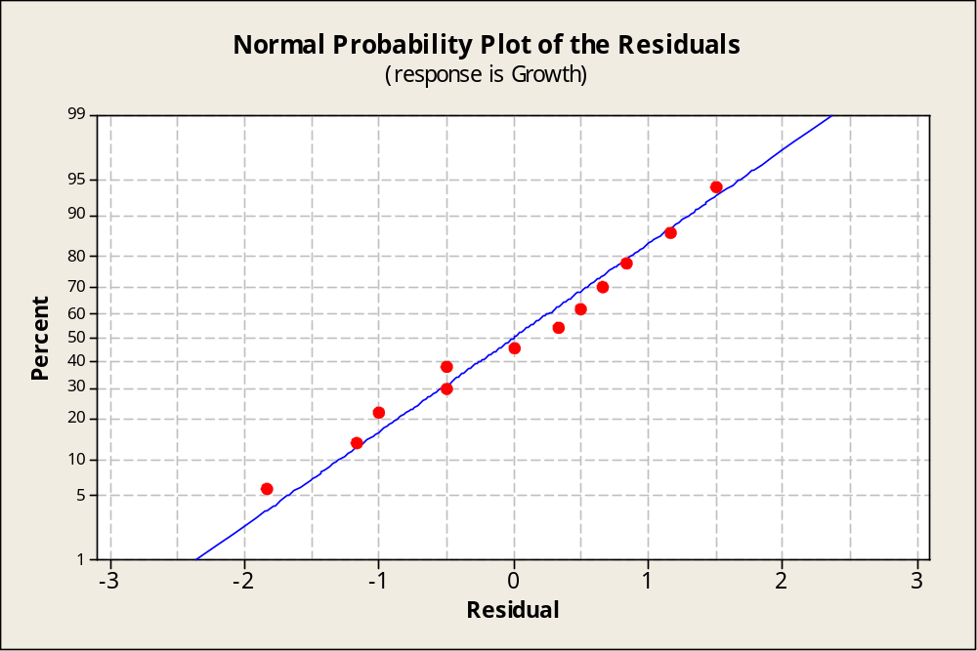
Normal Probability Plot
If the normality assumption is valid, the plot should resemble a straight line, sloping upward to the right.
If not, you will often see the pattern fail in the tails of the graph.

Slide 63
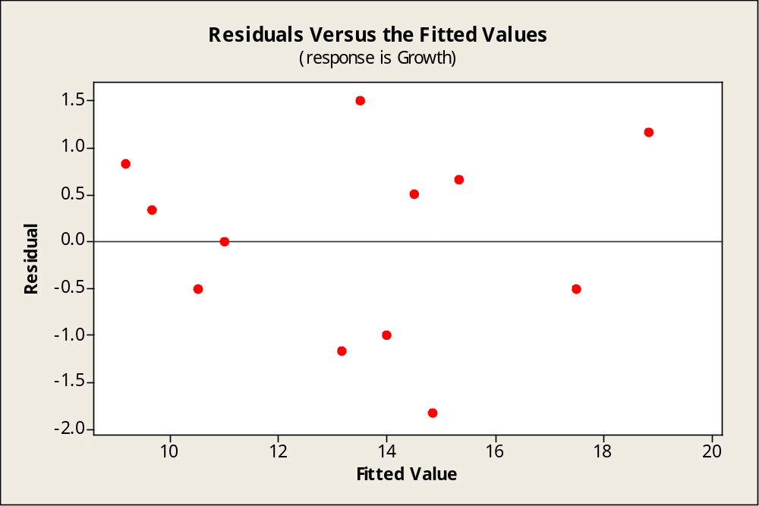
Residuals versus Fits
If the equal variance assumption is valid, the plot should appear as a random scatter around the zero center line.
If not, you will see a pattern in the residuals.

Slide 64
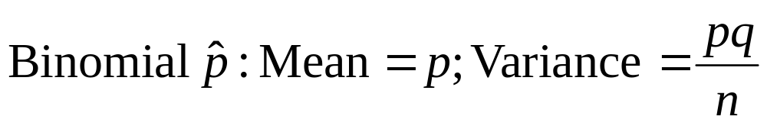
Some Notes
Be careful to watch for responses that are binomial percentages or Poisson counts. As the mean changes, so does the variance.
Residual plots will show a pattern that mimics this change.

Slide 65
Some Notes
Watch for missing data or a lack of randomization in the design of the experiment.
Randomized block designs with missing values and factorial experiments with unequal replications cannot be analyzed using the ANOVA formulas given in this chapter.
Use multiple regression analysis (Chapter 13) instead.

Slide 66
Key Concepts
I. Experimental Designs
1. Experimental units, factors, levels, treatments, response variables.
2. Assumptions: Observations within each treatment group
must be normally distributed with a common variance σ².
3. One-way classification—completely randomized design:
Independent random samples are selected from each of
k populations.
4. Two-way classification—randomized block design:
k treatments are compared within b blocks.
5. Two-way classification — a × b factorial experiment:
Two factors, A and B, are compared at several levels. Each factor– level combination is replicated r times to allow for the investigation of an interaction between the two factors.

Slide 67
Key Concepts
II. Analysis of Variance
1. The total variation in the experiment is divided into variation (sums of squares) explained by the various experimental factors and variation due to experimental error (unexplained).
2. If there is an effect due to a particular factor, its mean square(MS = SS/df ) is usually large and F = MS(factor)/MSE is large.
3. Test statistics for the various experimental factors are
based on F statistics, with appropriate degrees of freedom
(d f ₂ = Error degrees of freedom).

Slide 68
Key Concepts
III. Interpreting an Analysis of Variance
1. For the completely randomized and randomized block design, each factor is tested for significance.
2. For the factorial experiment, first test for a significant
interaction. If the interactions is significant, main effects need not be tested. The nature of the difference in the factor– level combinations should be further examined.
3. If a significant difference in the population means is found, Tukey’s method of pairwise comparisons or a similar method can be used to further identify the nature of the difference.
4. If you have a special interest in one population mean or the difference between two population means, you can use a confidence interval estimate. (For randomized block
design, confidence intervals do not provide estimates for single population means).

Slide 69
Key Concepts
IV. Checking the Analysis of Variance Assumptions
1. To check for normality, use the normal probability plot for the residuals. The residuals should exhibit a straight-line pattern, sloping upward to the right.
2. To check for equality of variance, use the residuals versus fit plot. The plot should exhibit a random scatter, with the same vertical spread around the horizontal “zero error line.”

